Slide 1




WEB TECHNOLOGYPROJECT
Doctor Appointment System
O.Lokeshwar Reddy –AP23110011150
K.Sri Akshaya-AP23110011163
Mehrosh sultana-AP23110011212
R.Phani Sree-AP23110011213
K.Sumana Sree-AP23110011203

Slide 2

Introduction
Main page consists :-
doctor login
patient register and patient login
About us-contains a video and small info about website
Services:-
Book appointments
Online appointments
Offline appointments
Buy medicines
Book lab tests
Book to home appointment
Book for offline appointment

Slide 3
Contact us through what’s app
Contact us by normal call
Displaying the database tables
Website logo

Slide 4

DOCTOR LOGIN
Used table in database:- doctordetails
To view their respective profile they have to login with following credentials which are already stored in table (doctordetails) of database(hospital _application):-
Name
Password

Slide 5
Inside view of their respective profiles
Doctor image
Name with specialization
Experience
Total no of patients they treated
Total amount they earned (i.e ₹300/- fixed for each patient for both modes)
Rating (for online-it’s varies
for Offline fixed)
Upcoming appointments
Pie chart(regarding patient distribution fixed for all doctors)

Slide 6

Patient register
Used table in database:- patient
It contains a form to fill their details to get access to both modes with following details:-
Name
Email
Phone number
Preferred language
Gender
Age
Password along with confirm password
Submit button
Finally after submitting it will redirect to home page

Slide 7
Patient login
To view their respective profile they have to login with following credentials which they already signup and which it is stored in table (patient) of database(hospital _application):-
Name
Password

Slide 8
Inside view of their respective profiles
Name
Age
Blood group
Booking
Previous reports

Slide 9

Our Services
Service -1 → online appointment
Used table in database:- booking_slots and doctor_ratings
Demo video indicating importance of online bookings
5 types of specializations available:-
Pediatrics
Gynecology
Endocrinology
General checkup
Psychiatry

Slide 10
Each specialization consists of one female and one male doctors with 3 buttons:-
About us
Linked-in account and extra info of their education background and their required details
Book now
Name of the patient
Age of the patient
Sessions-(Morning, Afternoon ,Evening) to book slots
Each session contains 5 different slots
Slots timing are different for female doctor and male doctor
Rating
with 5 star and comment box

Slide 11
Service -2 → offline appointment
Used table in database:- offline_appointments
5 Locations(each contains one hospital)
Select the respective hospital name for that location
5 types of specializations available:-
Pediatrics
Gynecology
Endocrinology
General checkup
Psychiatry
After selecting specialization select doctor which has female and male doctors

Slide 12
4 slots are available for any doctors in any specialization
After submitting it will direct to patient form
Patients details form contains:-
Name
Age
Phone number
Date
After submitting it will store the data into respective table of the database(hospital_application)
Finally Patient’s booking details stored in table will display on the page

Slide 13





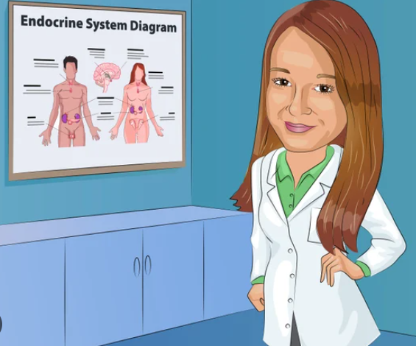

Our online team
Dr. Shruti Nair
Dr. Vijay Reddy
Dr. Anjali Reddy
Dr. Ravi Kumar
Dr. Divya Kumar
Dr. Arun Prasad

Slide 14




Dr. Priya Srinivasan
Dr. Rajesh Nair
Dr. Lakshmi Iyer
Dr. Karthik Varma

Slide 15


Our offline team
Same icon for male and female as above
There are total 50 doctors (25-female and 25-male)

Slide 16

Lab tests facilities
facility 1 → booking at hospital
Used table in database:- hospital_labbookings
5 different lab tests
Blood test
X-Ray
MRI Scan
CT Scan
ECG

Slide 17
After selecting any type of testing it will display booking details form
Patient name
Hospital
5 types of places with respective hospital
date
Submit button(book test)
After submitting it will store details backend
It will display booking conformation details of patients of lab test

Slide 18
facility 2 → booking at home
Used table in database:- home_lab_bookings
It will display a form with :-
Name
Contact number
5 different types of tests with the price
Price → fixed from the test
Date
Time
address
Submit button(book now)
Pop a message successfully booked and it store details in backend

Slide 19
facility 3→ Buy medicines
Used table in database:- home_lab_bookings
It will display a form with :-
It will check with already existing prescriptions table and displays details if found
Appointment number
Patient name
Doctor name
Appointment date
Submit button

Slide 20



Contact Us
+918465061466
+918499099949

Slide 21

THANK
YOU

